Slide 1
WORKING WITH HADOOP
Dr.E.Sivasankar, NIT,Tiruchirappalli-15

Slide 2
Hadoop
Hadoop is an open-source framework to store and process Big Data in a distributed environment. It contains two modules, one is MapReduce and another is Hadoop Distributed File System (HDFS).
MapReduce: It is a parallel programming model for processing large amounts of structured, semi-structured, and unstructured data on large clusters of commodity hardware.
HDFS:Hadoop Distributed File System is a part of Hadoop framework, used to store and process the datasets. It provides a fault-tolerant file system to run on commodity hardware

Slide 3
Hadoop
The Hadoop ecosystem contains different sub-projects (tools) such as Sqoop, Pig, and Hive that are used to help Hadoop modules.
Sqoop: It is used to import and export data to and from between HDFS and RDBMS.
Pig: It is a procedural language platform used to develop a script for MapReduce operations.
Hive: It is a platform used to develop SQL type scripts to do MapReduce operations.

Slide 4
Introduction to Big Data
Three attributes stand out as defining Big Data characteristics:
● Huge volume of data: Rather than thousands or millions of rows, Big Data can be billions of rows and millions of columns.
● Complexity of data types and structures: Big Data reflects the variety of new data sources, formats, and structures, including digital traces being left on the web and other digital repositories for subsequent analysis.
● Speed of new data creation and growth: Big Data can describe high velocity data, with rapid data ingestion and near real time analysis.

Slide 5
Typical Analytical Architecture
1. For data sources to be loaded into the data warehouse, data needs to be well understood, Structured, and normalized with the appropriate data type definitions.
This kind of centralization enables security, backup, and failover of highly critical data ( a procedure by which a system automatically transfers control to a duplicate system when it detects a fault or failure) it also means that data typically must go through significant pre-processing and checkpoints before it can enter this sort of controlled environment.
2. As a result of this level of control on the enterprise data warehouse EDW, additional local systems may emerge in the form of departmental warehouses and local data marts that business users create to accommodate their need for flexible analysis.
These local data marts may not have the same constraints for security and structure as the main EDW and allow users to do some level of more in-depth analysis.

Slide 6
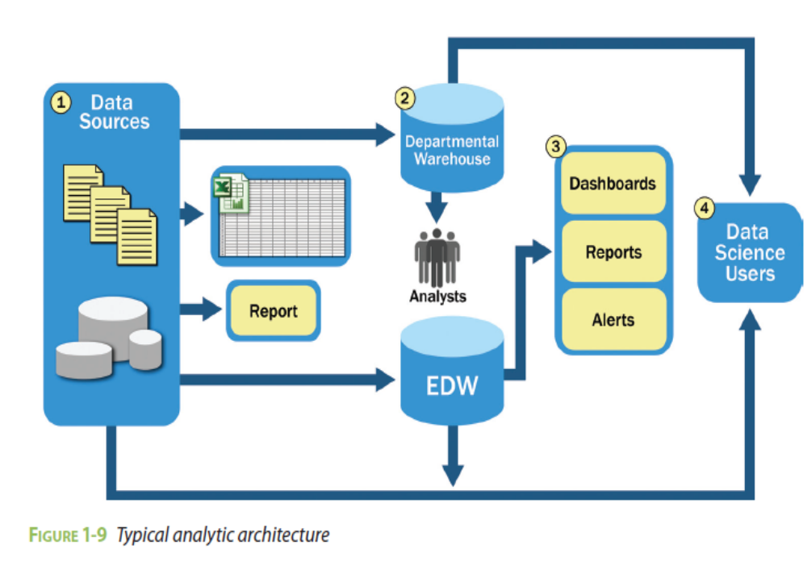

Slide 7
3. In the data warehouse, data is read by additional applications across the enterprise for BI and reporting purposes. These are high-priority operational processes getting critical data feeds from the data warehouses and repositories.
4. At the end of this workflow, analysts get data provisioned for their downstream analytics. Because users generally are not allowed to run custom or intensive analytics on production databases, analysts create data extracts from the EDW to analyze data offline in R or other local analytical tools.
Many times these tools are limited to in-memory analytics on desktops analyzing samples of data, rather than the entire population of a dataset.

Slide 8
HIVE
Hive is a data warehouse infrastructure tool to process structured data in Hadoop. It resides on top of Hadoop to summarize Big Data, and makes querying and analyzing easy.
Initially Hive was developed by Facebook, later the Apache Software Foundation took it up and developed it further as an open source under the name Apache Hive.
It is used by different companies. For example, Amazon uses it in Amazon Elastic MapReduce.

Slide 9
Features of Hive
It stores schema in a database and processed data into HDFS.
It is designed for OLAP.
It provides SQL type language for querying called HiveQL or HQL.
It is familiar, fast, scalable, and extensible.

Slide 10
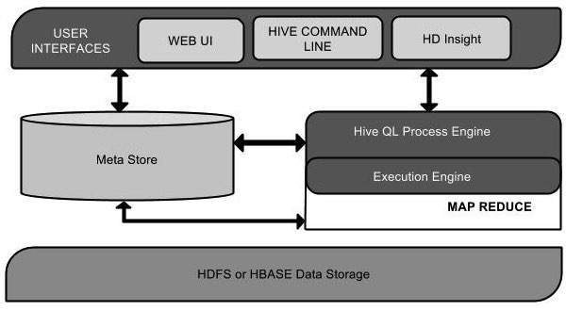
Architecture of Hive
The following component diagram depicts the architecture of Hive:

Slide 11
Architecture of Hive
User Interface
Hive is a data warehouse infrastructure software that can create interaction between user and HDFS.
The user interfaces that Hive supports are Hive Web UI, Hive command line, and Hive HD Insight (In Windows server).
Meta Store
Hive chooses respective database servers to store the schema or Metadata of tables, databases, columns in a table, their data types, and HDFS mapping.

Slide 12
Architecture of Hive
HiveQL Process Engine
HiveQL is similar to SQL for querying on schema info on the Metastore.
It is one of the replacements of traditional approach for MapReduce program.
Instead of writing MapReduce program in Java, we can write a query for MapReduce job and process it.
Execution Engine
The conjunction part of HiveQL process Engine and MapReduce is Hive Execution Engine. Execution engine processes the query and generates results as same as MapReduce results. It uses the flavor of MapReduce.
HDFS or HBASE
Hadoop distributed file system or HBASE are the data storage techniques to store data into file system.

Slide 13
Limitations of Hive
Hive is not capable of handling real-time data.
It is not designed for online transaction processing.
Hive queries contain high latency.

Slide 14
Sqoop
Sqoop is a command-line interface application for transferring data between relational databases and Hadoop.
It supports incremental loads of a single table or a free form SQL query as well as saved jobs which can be run multiple times to import updates made to a database since the last import.Using Sqoop, Data can be moved into HDFS/hive/hbase from MySQL/ PostgreSQL/Oracle/SQL Server/DB2 and vise versa.

Slide 15
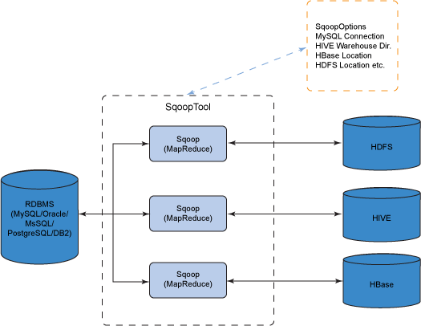
Sqoop

Slide 16
HBase
Hbase is an open source and sorted map data built on Hadoop. It is column oriented and horizontally scalable.
It is based on Google's Big Table.It has set of tables which keep data in key value format. Hbase is well suited for sparse data sets which are very common in big data use cases. Hbase provides APIs enabling development in practically any programming language. It is a part of the Hadoop ecosystem that provides random real-time read/write access to data in the Hadoop File System.

Slide 17
HBase
RDBMS get exponentially slow as the data becomes large
Expects data to be highly structured, i.e. ability to fit in a well-defined schema
Any change in schema might require a downtime
For sparse datasets, too much of overhead of maintaining NULL values

Slide 18
Features of HBase
Horizontally scalable: You can add any number of columns anytime.
Automatic Failover: Automatic failover is a resource that allows a system administrator to automatically switch data handling to a standby system in the event of system compromise
Integrations with Map/Reduce framework: All the commands and java codes internally implement Map/ Reduce to do the task and it is built over Hadoop Distributed File System.
sparse, distributed, persistent, multidimensional sorted map, which is indexed by rowkey, column key,and timestamp.

Slide 19
Features of HBase
Often referred as a key value store or column family-oriented database, or storing versioned maps of maps.
fundamentally, it's a platform for storing and retrieving data with random access.
It doesn't care about datatypes(storing an integer in one row and a string in another for the same column).
It doesn't enforce relationships within your data.
It is designed to run on a cluster of computers, built using commodity hardware.

Slide 20
HBase Read
A read against HBase must be reconciled between the HFiles, MemStore & BlockCache.
The BlockCache is designed to keep frequently accessed data from the HFiles in memory so as to avoid disk reads.
Each column family has its own BlockCache.
BlockCache contains data in form of 'block', as unit of data that HBase reads from disk in a single pass.
The HFile is physically laid out as a sequence of blocks plus an index over those blocks.
This means reading a block from HBase requires only looking up that block's location in the index and retrieving it from disk.

Slide 21
HBase Write
When a write is made, by default, it goes into two places:
  write-ahead log (WAL), HLog, and
  in-memory write buffer, MemStore.
Clients don't interact directly with the underlying HFiles during writes, rather writes goes to WAL & MemStore in parallel.
Every write to HBase requires confirmation from both the WAL and the MemStore.

Slide 22
HBase MemStore
The MemStore is a write buffer where HBase accumulates data in memory before a permanent write.
Its contents are flushed to disk to form an HFile when the MemStore fills up.
It doesn't write to an existing HFile but instead forms a new file on every flush.
The HFile is the underlying storage format for HBase.
HFiles belong to a column family(one MemStore per column family). A column family can have multiple HFiles, but the reverse isn't true.
size of the MemStore is defined in hbase-site.xml called hbase.hregion.memstore.flush.size.

Slide 23
In-Database Analytics
In-database analytics is a model of analysis where the processing of data
is performed within a database.
By processing the data within a database, it allows for the elimination
of the overhead of moving large data sets to analytic applications.

Slide 24
In-Database Analytics
Analytic capabilities embedded in a relational or columnar database.
The phrase is also used to describe analytic capabilities embedded in data warehouse software, in data appliances and increasingly in Hadoop clusters.
In-database processing, sometimes referred to as in-database analytics, refers to the integration of data analytics into data warehousing functionality.
Today, many large databases, such as those used for credit card fraud detection and investment bank risk management, use this technology because it provides significant performance improvements over traditional methods

Slide 25
Loading C or C++ libraries into the database process space
With C or C++ UDF libraries that run in process, the functions are typically registered as built-in functions within the database server and called like any other built-in function in a SQL statement.
Running in process allows the function to have full access to the database server’s memory, parallelism and processing management capabilities.

